Slide 1
ZooKill Soccer
A Game Design Document
Created by: Your Name

Slide 2
How to do this…
Read the Game Description
Follow the description in class
Check the assets provided by the Instructor
Create a workflow on 1 or more slides
As you code, add the JavaScript objects associated with the Game objects
Turn in in Week 11
Resource: https://medium.com/@WebdesignerDepot/how-to-design-html5-games-a5617f80e03f#.6ou4j4z0e

Slide 3
Game Design Document - 1
Animals are breaking out of their Zoo Cages!
Your job is to kick Trump like a soccer ball so that he collides with a Zoo Animal
If you successfully kick Trump into the path of an escaping Zoo Animal, it will “do what it will” to Trump and return to its cage
Otherwise, the Zoo Animal will come after YOU.

Slide 4
Game Design Document - 2
Sequence
At the start of the game, the cages open
Animals drift down the screen to attack you
You have a Trump which you can kick into their path
Each animal who collides with Trump is satisfied, and returns to its cage
An animal who makes it past Trump will attack YOU (game over)

Slide 5
The Characters
You (your foot, since your kicking Trump like he was a soccer ball)
The Animals (4 of them, in cages at the top of the screen)
Trump (next to your foot at the start so you can kick him but possibly could exit the screen if you don’t keep kicking him into the upper region of the screen

Slide 6
Game Design Document - 3
You WIN the game by returning all animals to their cages, while Trump is still functional
You LOSE the game if Trump becomes non-functional, or a Zoo Animal manages to grab YOU

Slide 7
Create Consensus Diagram as a GROUP
Do hand-sketches like the Medium article
https://medium.com/@WebdesignerDepot/how-to-design-html5-games-a5617f80e03f#.6ou4j4z0e
Share the sketches
Pick a final hand-drawn diagram as a group
Make sure everyone has this diagram

Slide 8
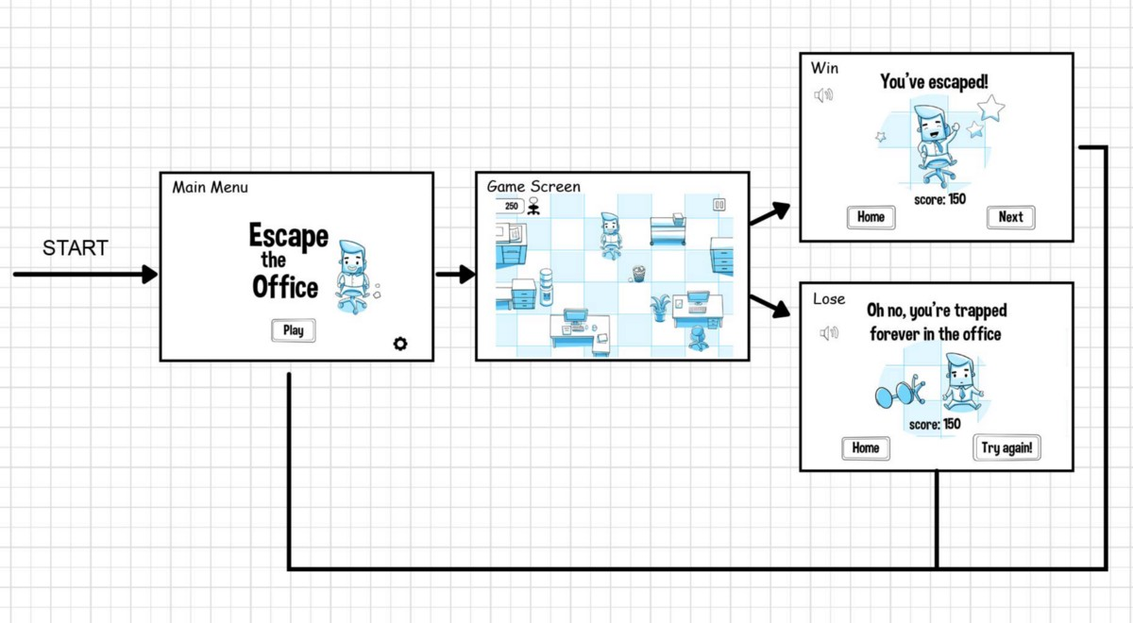
Post Completed Consensus Diagram
Put consensus diagram on Slack Channel http://frontendunicorns.slack.com

Slide 9
Add JS Objects
Use the consensus diagram as a starting point
As you code in Week 06 – 11, list the JS objects involved in each scene
You can do this by hand, or electronically
You may need to “break out” scenes in greater detail
This will provide documentation for your project

Slide 10
Base Objects

Slide 11
Week 11 Upload
Upload your diagram, with included JS objects to the course shell.

